Slide 1
SEPCARE COMPANY PROJECT
Out-of-pocket expenses for patients affected by Multiple Sclerosis (MS)
Naila Bouterfa

Slide 2
Context and methodology
Sepcare, a leader in the sphere of treatments for MS, wishes to carry out an economic evaluation of the out-of-pocket costs (coinsurance) that patients have to cover. They would especially like to understand the impact of the severity of the condition on the out-of-pocket costs.
Eventually, Sepcare would like to publish the results of this study, in order to build up a dialogue with various stakeholders (politicians, representatives of patients’ associations, insurance companies…)
Members of the MS community on Carenity were invited by email to take part in the study. The questionnaire is hosted on Carenity.com.
57 patients have started the questionnaire (50 correspond to the study criteria and have completed the survey).

Slide 3
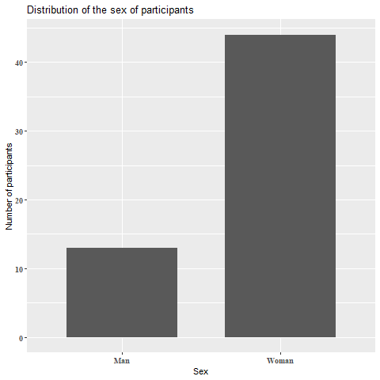
Respondant’s profile
57 persons responded to the study (50 patients and 7 caregivers)
with a majority of women (13 men vs 44 women)
The mean value for the first symptoms apparition in patients is 16,5 years old
For the diagnosis : around 36 years old
A majority of participents do not work because of MS (19)

Slide 4
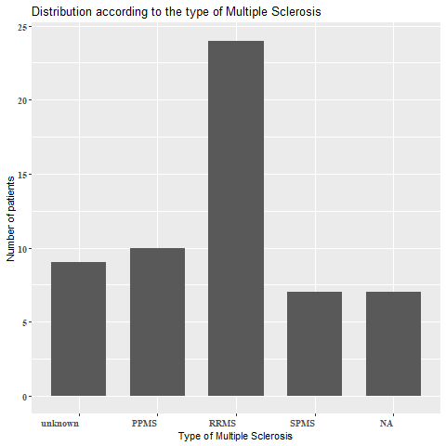
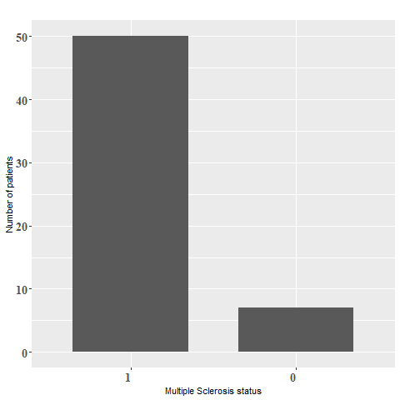
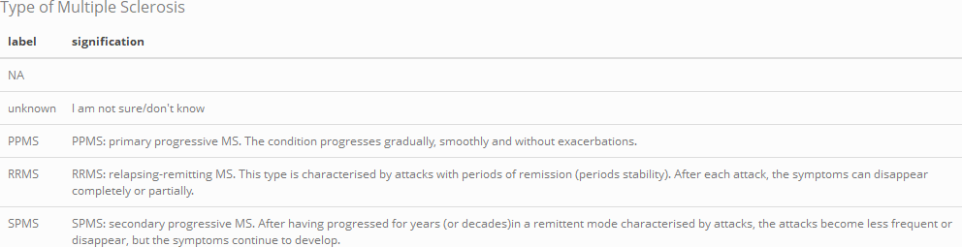

Respondant’s profile
50 participants have MS
24 patients have RRMS (almost 50%)

Slide 5

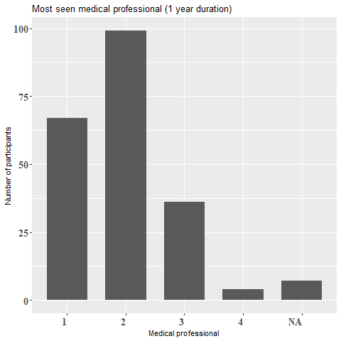
Most consulted medical professionels
For Multiple Sclerosis, patients tend to go more often to the neurologist, more than the general practitioner

Slide 6
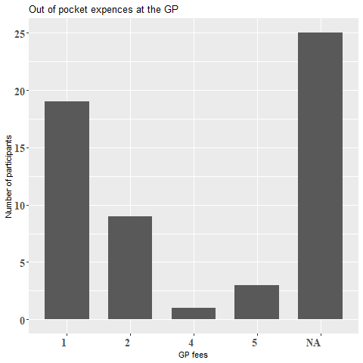
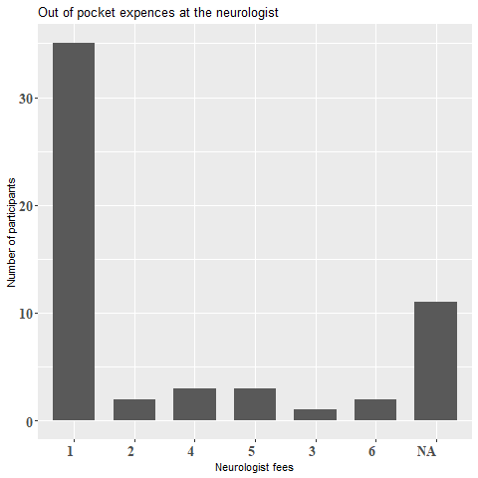
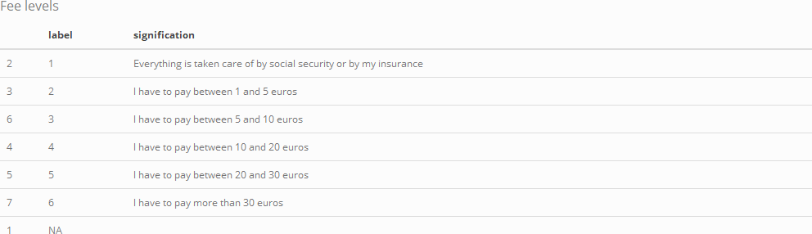
Out-of-pocket expences
For the two most consulted medical specialist, out-of-pocket expences are usually low of absent.

Slide 7
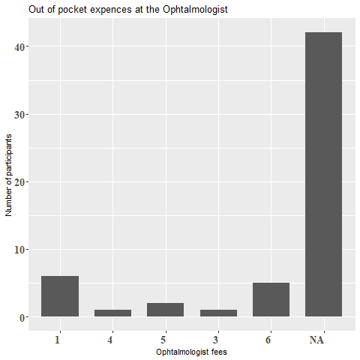
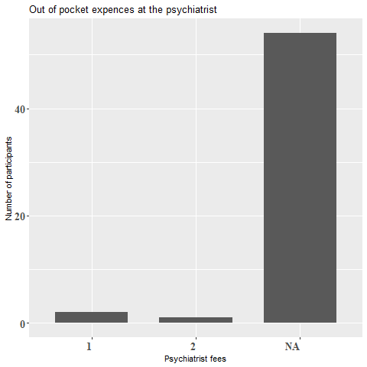
Out-of-pocket expences
Patients consult less often ophtalmologist and psychiatrists
For a few patients out-of-pocket expences at the ophtalmologist are either absent or high and for the psychiatrist absent or very low

Slide 8
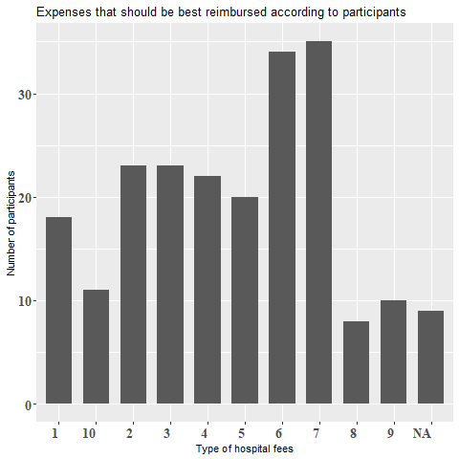
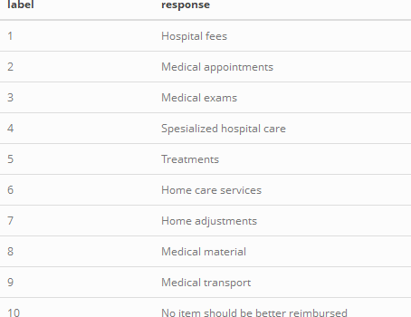
Reimbursement preferences
The top pick for the expenses that should be better reimbursed is home adjustments and home care services

Slide 9
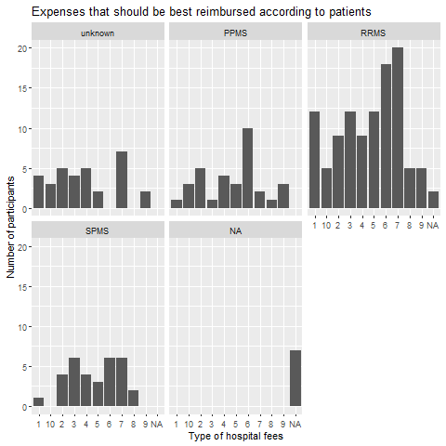

Reimbursement preferences
Here we can see that the demand for home adjustment reimbursement is top priority for the patients with RRMS which is the most difficult form of the disease, home care services reimbursement come as well as a concern in 2nd position for RRMS and 1st for PPMS

Slide 10
Conclusion
As there is no need to think that out-of-the-pocket expenses are high for the most frequent medical visits, we notice that the demand of patients for better reimbursement in home adjustments and home care services is important
It might be interesting to better reimburse medical appointments and medical exams in second hand since they are mentioned often in the reimbursement preferences as well.

